Slide 1
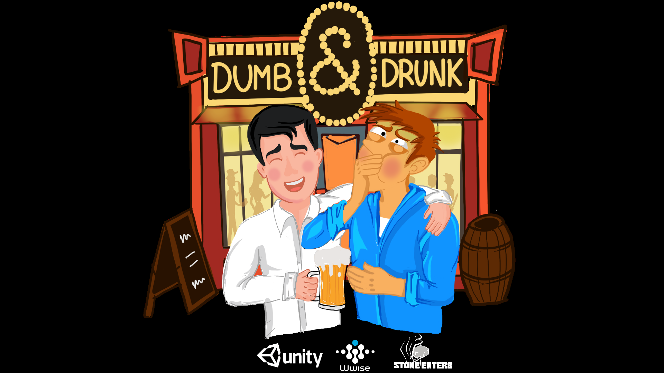

Slide 2

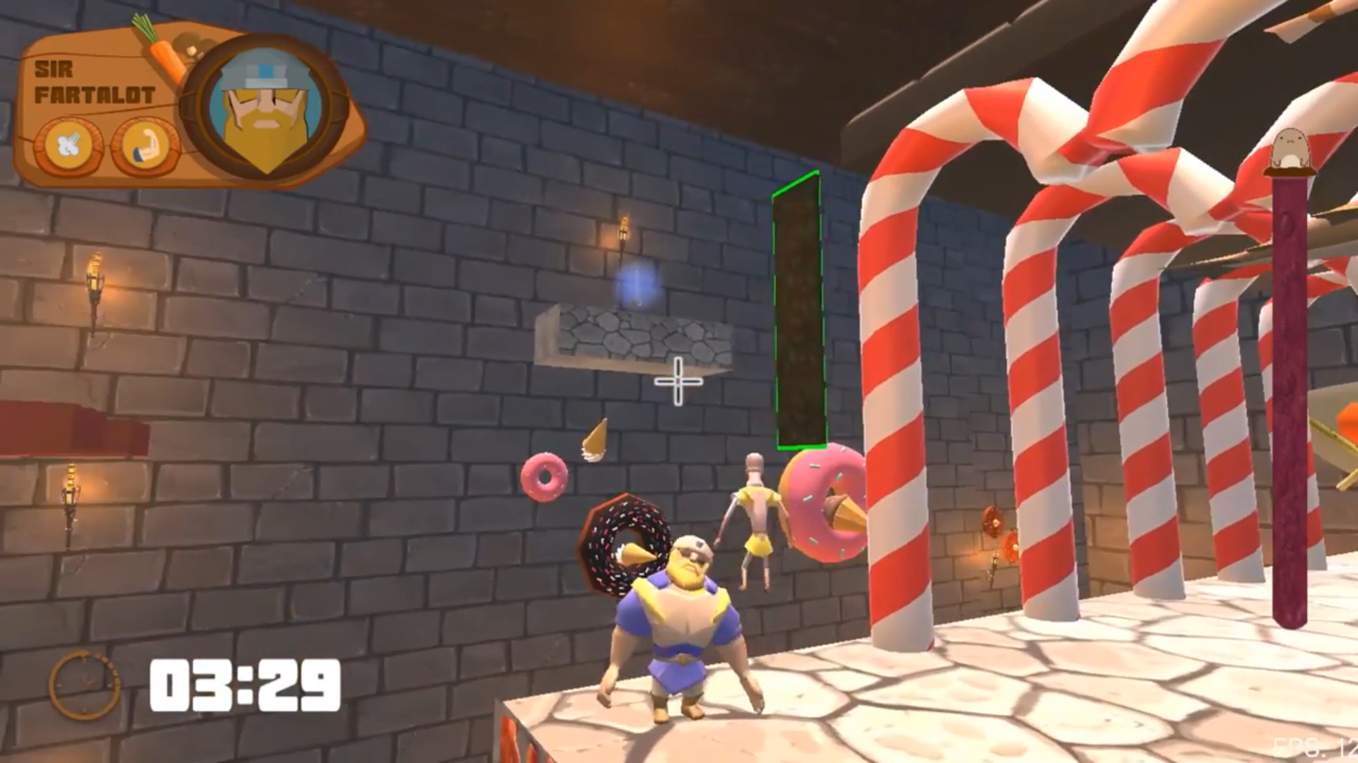
DEVELOPMENT TEAM
Founded in Milan for NGD 2018.

Slide 3

PROJECT OVERVIEW
Party game where you play with or against your friends. Teams are mixed every round, but only one can win.
Working title: Dumb&Drunk
Genre: couch party game
Format: PC, PS4. Controlled with Android.
Target audience: casual players
# Players: 4 players
Tech: Unity 3D

Slide 4



STORY
Four friends and roommates return to NYC after the holidays, so they decide to have a drink together.
After too much beers they return home, but only one bed is usable! The one who reach it first will sleep confortable on it, while the others will sleep on the hard and cold floor.

Slide 5
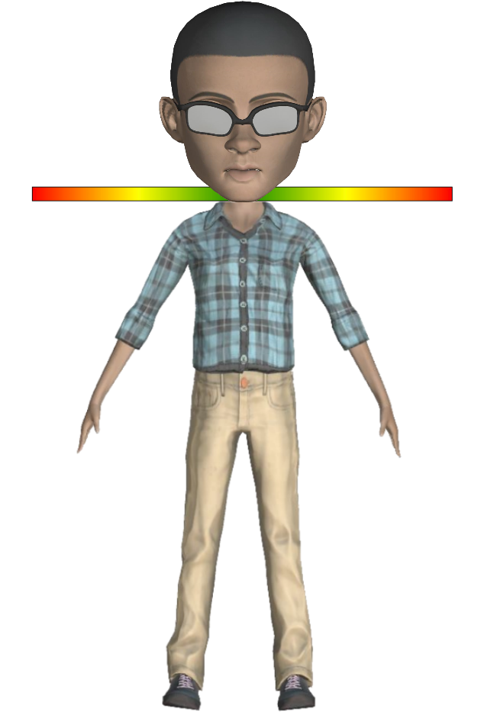
GAMEPLAY FEATURES
Absurd controls: 4 buttons, each controlling a different limb.
Random-chosen controls and axes. Every time you fall, they change.
Different difficulties: each crazier than the other
Balance Bar: tilt the phone to keep the player on his feet

Slide 6





GAMEPLAY FEATURES
Matches: divided in rounds. The first player to reach 10 points wins.
Round: divided in two phases, the winner/s of each phase gains 1 point:
1° phase: players are divided in 2 teams and try to collect keys.
2° phase: the two players who won the first phase race each other, while the others try to make them fall.

Slide 10

UNIQUE SELLING POINTS
Party game for PC and PS4, controlled using smartphones.
Rounds where teams are mixed every time, balancing the game.
A lot of different stereotyped cities (NYC, Paris, etc.), every of them with their obstacles, scenarios, sounds and characters.

Slide 11
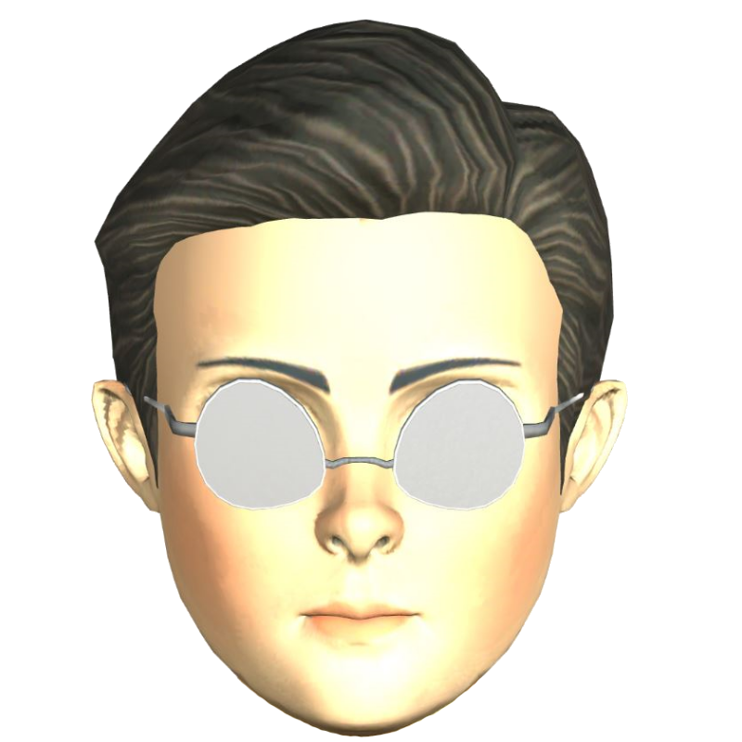
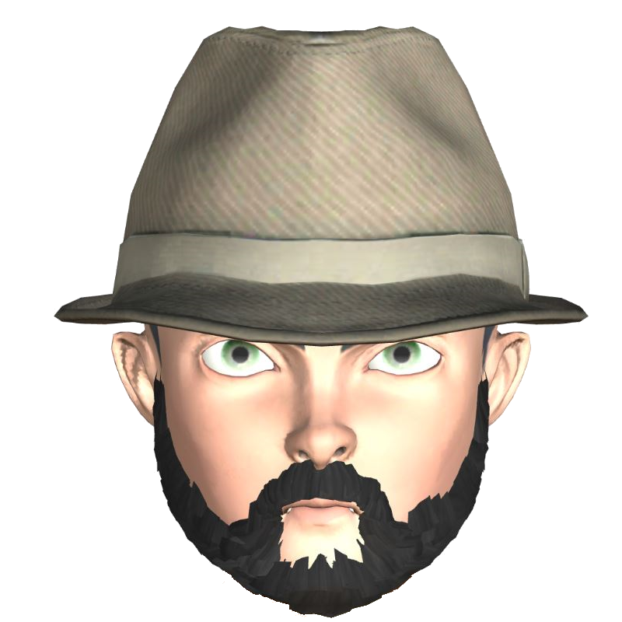
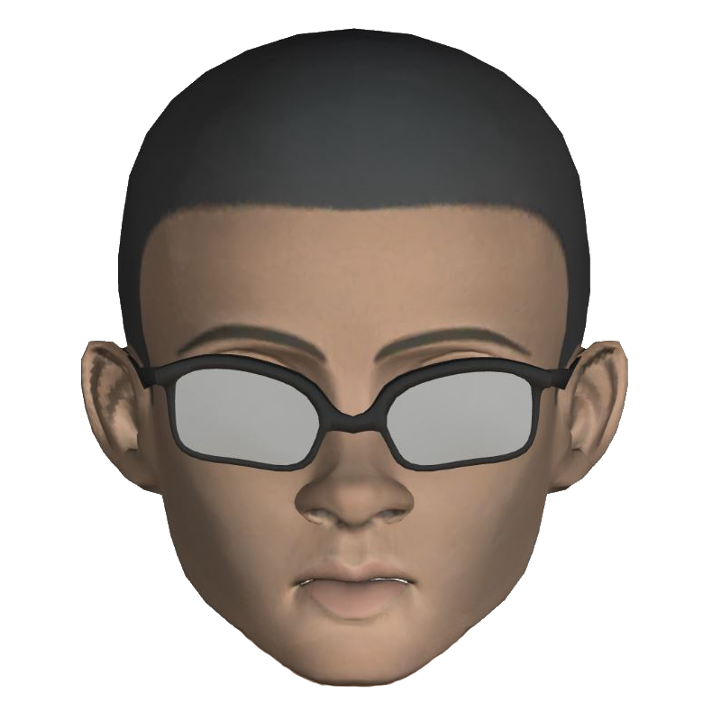
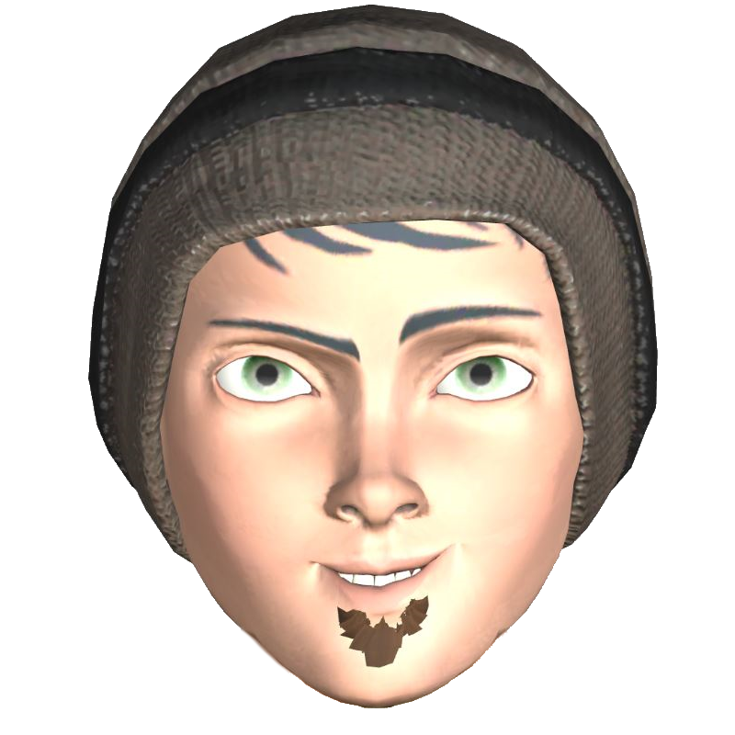
EXECUTIVE SUMMARY
Coop and PVP couch party game
Casual players
PC and PS4
Controlled by smartphones
Random controls
Different stereotyped scenarios

Slide 12
